Slide 1

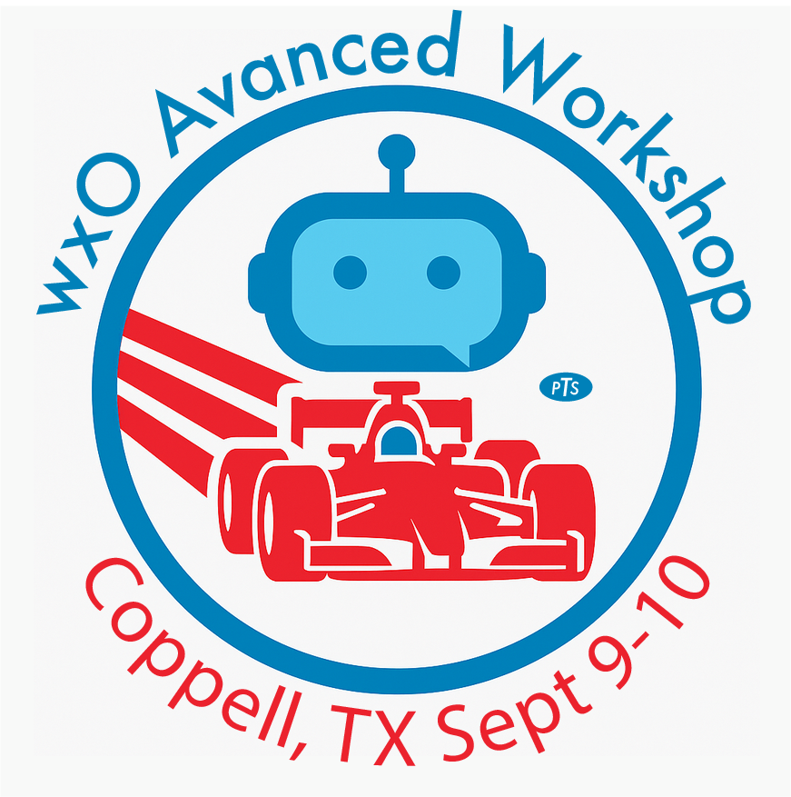
IBM watsonx Orchestrate Advanced Workshop
Daniel Benner Partner Technical Specialist - Partner
dbenner@us.ibm.com
512.825.6186
Notes:
Welcome to the wxO Advanced workshop!

Slide 2
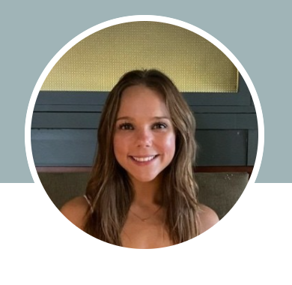
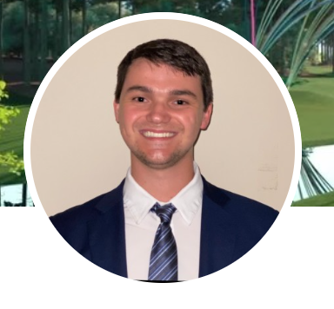
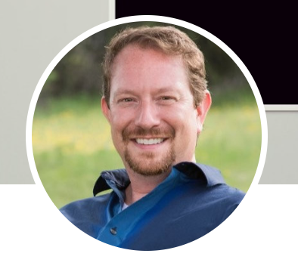
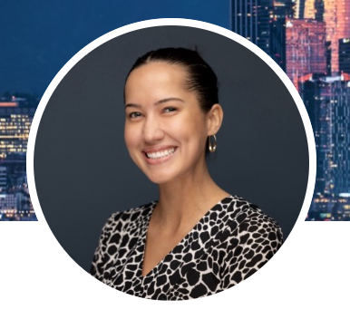
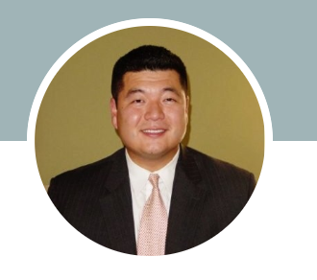
Your coaches for the workshop
Sara Hrnciar
TD SYNNEX
Collin Stiffler
IBM
Daniel Benner
IBM
Sofia Southard
IBM
Eugene Jung
IBM
Notes:
Let me tell you something about the people you're working with today and tomorrow – every single one of these coaches has put in dozens and dozens of hours crafting this workshop for you. They're not just instructors, they're YOUR coaches for the next two days.
I also want to give a shout-out to TD SYNNEX – they're the ones sponsoring this workshop. And here's what's really cool about that – you're literally surrounded by people who actually use TD SYNNEX as their value-added distributor. Bottom line you're learning from folks who are doing this stuff in the real world.
We've also got some great people here from IBM and TD SYNNEX who'll be around throughout the workshop. Don't be shy – you'll have plenty of chances to connect with them, pick their brains, maybe grab coffee and hear about what they're seeing out there in the field. These are exactly the kinds of conversations that can really make a difference in how you approach your own work.

Slide 3

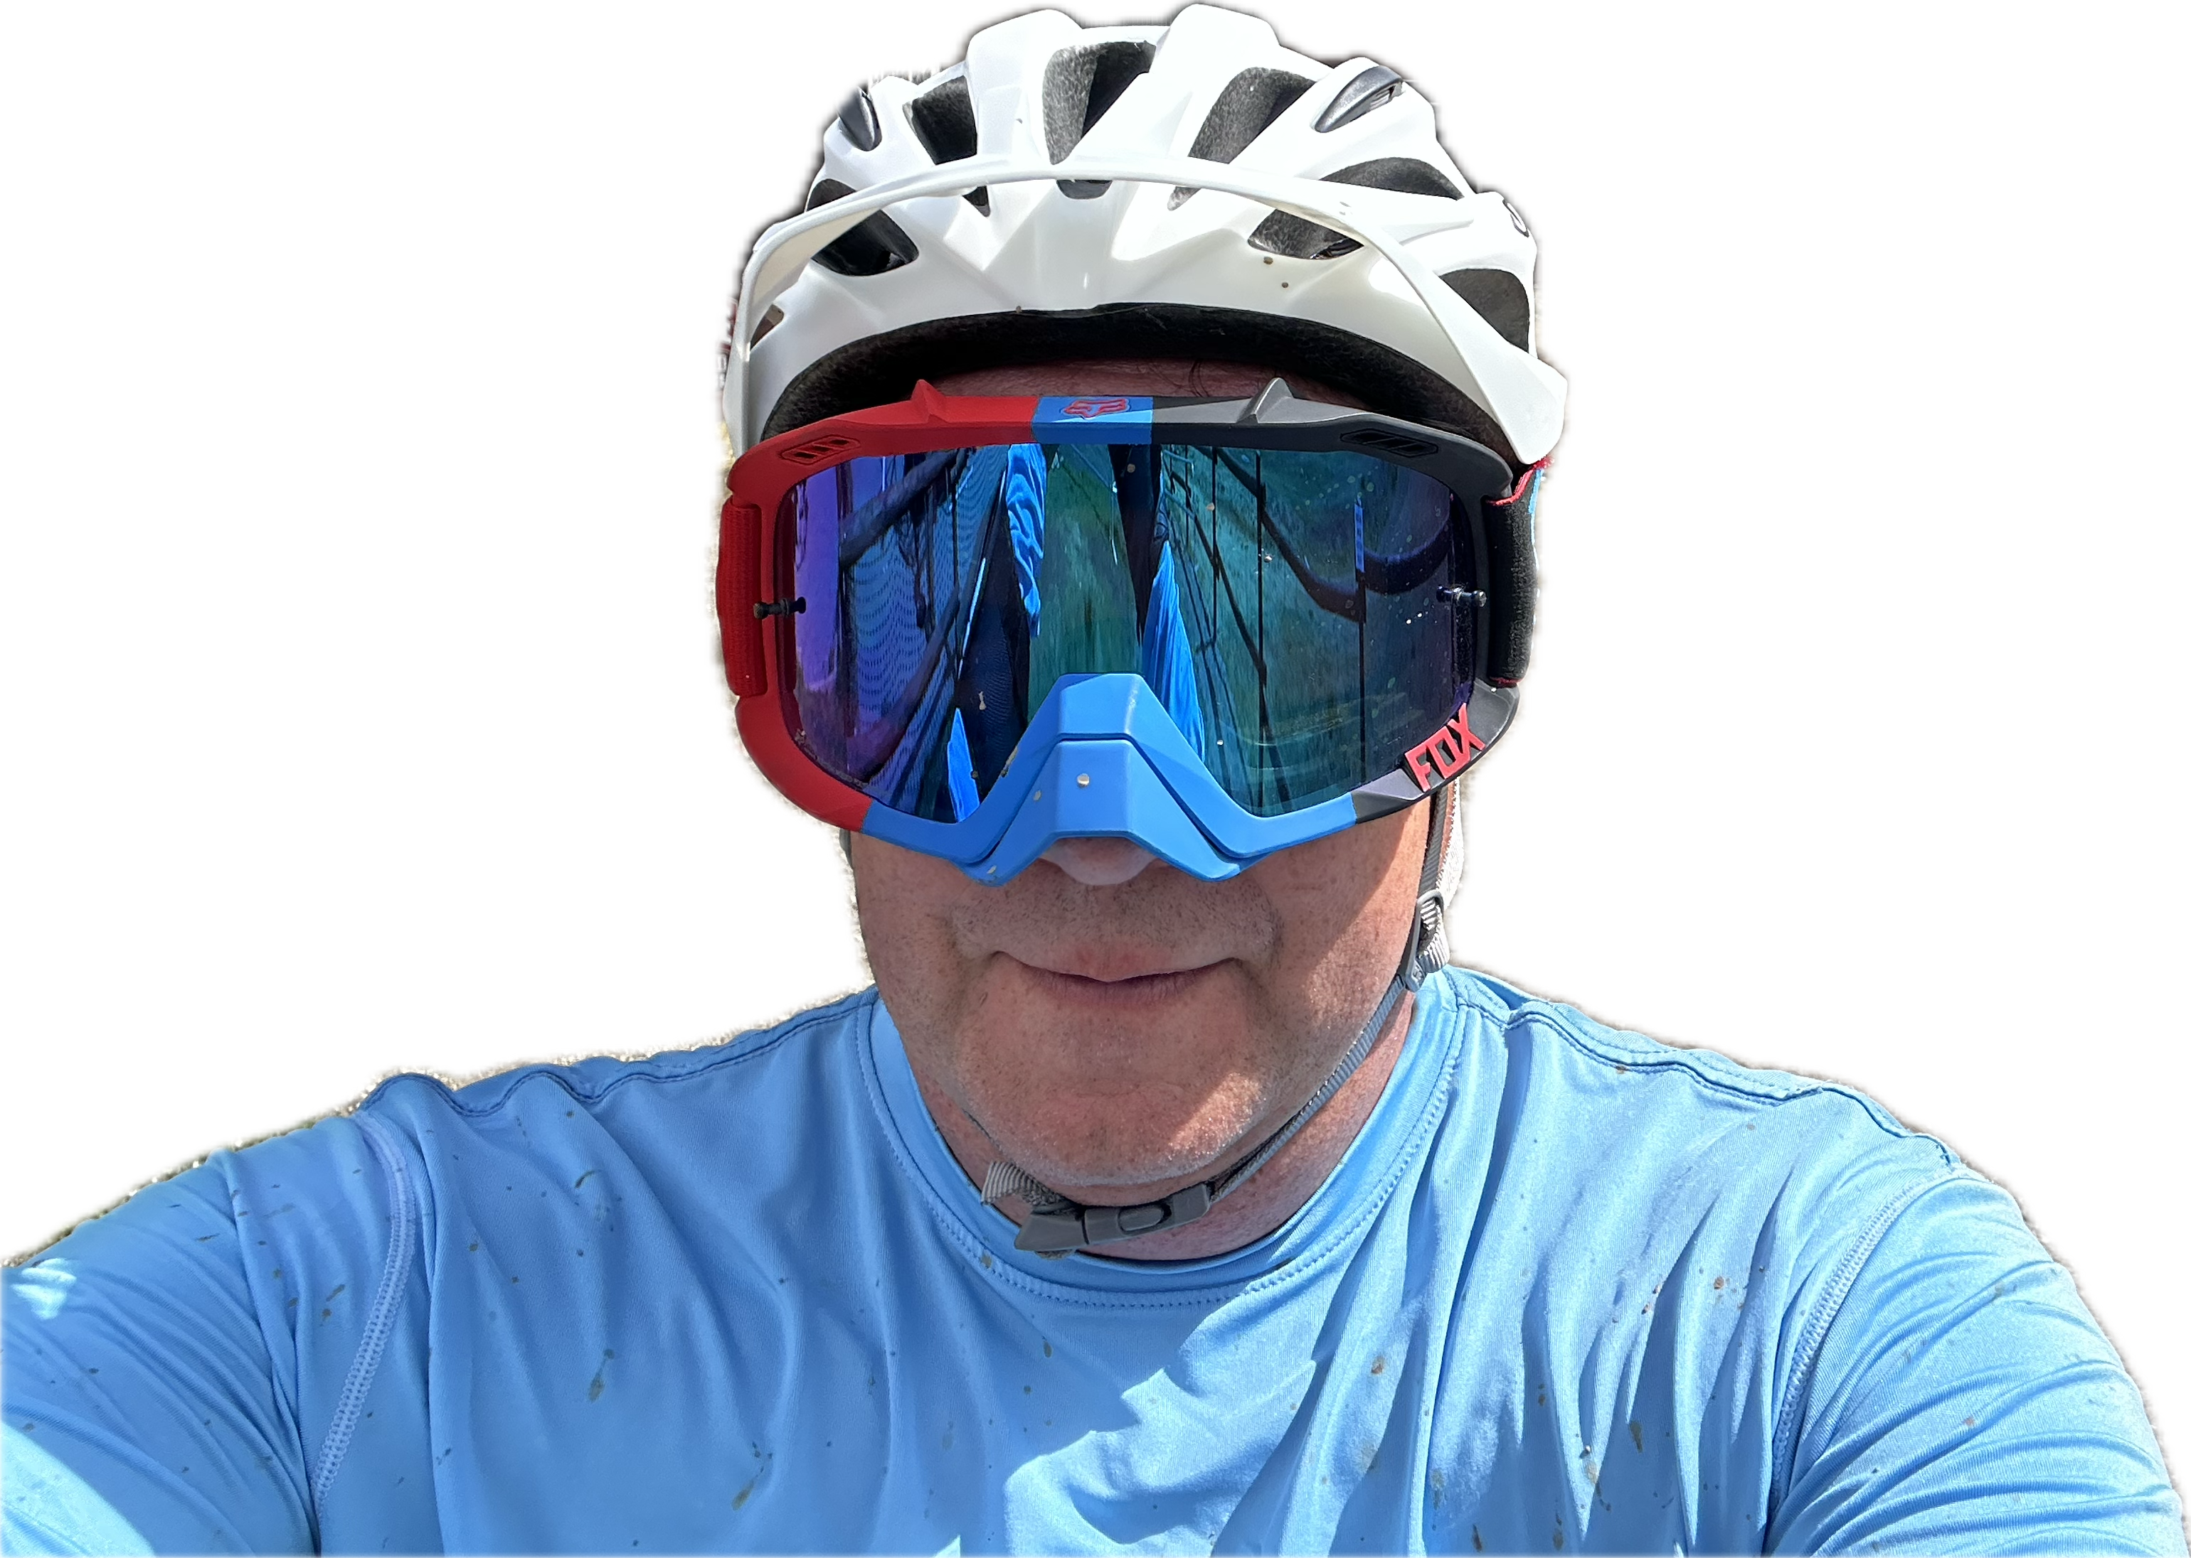
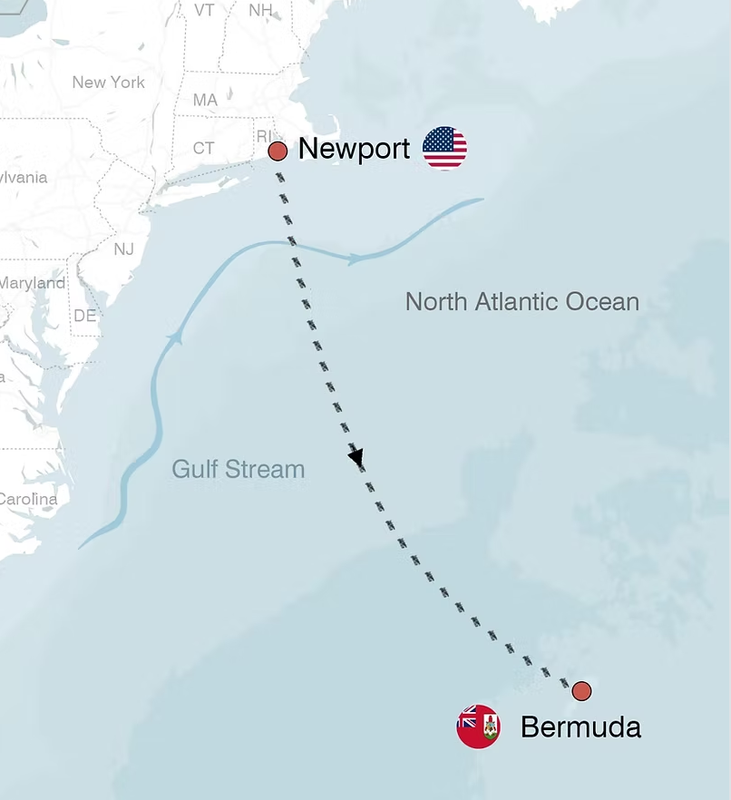
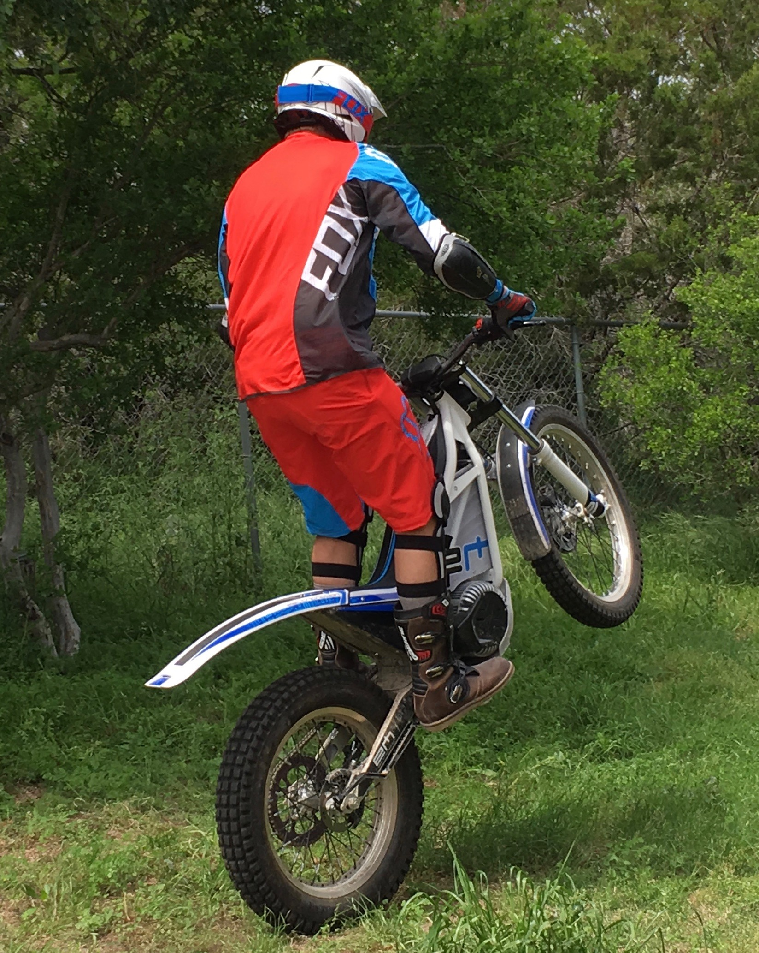
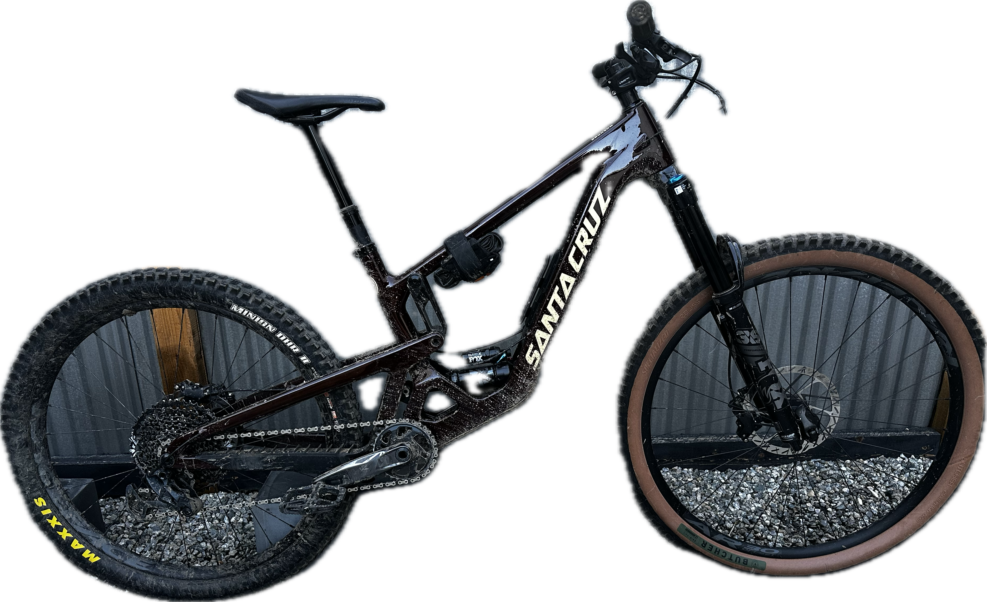
About Daniel Benner
what skills will do you have in the garage?
Daniel Benner Partner Technical Specialist – Partners (PTS-P)
Work Interests:
Design Thinking
Agentic AI
Automation
Hobbies:
Sailing (costal, blue water)
Mountain biking (trail, downhill)
Trials (motorcycle w/o seats)
Garage band (karaoke, percussion)
Movies
dbenner@us.ibm.com
512.825.6186
too many?
Notes:
So, I'm just getting back from an awesome trip to Crested Butte, Colorado! I took my mountain bike up a ski lift and then just flew down these incredible trails with huge banked turns, jumps, and winding singletrack through groves of aspen trees. It was amazing!
And the next adventure is already lined up. At the end of October, I'm hopping on a 60-foot sailboat for a 700-nautical-mile journey from Newport, Rhode Island, to Bermuda. I'll be learning all about open-ocean sailing and, you know, hopefully dodging any hurricanes!
As much as I'd love to just talk about my hobbies all day, my boss is right here, so... back to work! He's actually the one who put me on the path to my current role as the first-ever ecosystem expert for watsonx Orchestrate.
When it comes down to it, my real passion is figuring out how to learn new things. And honestly, in the fast-moving world of AI, that's the most important skill you can have.

Slide 4
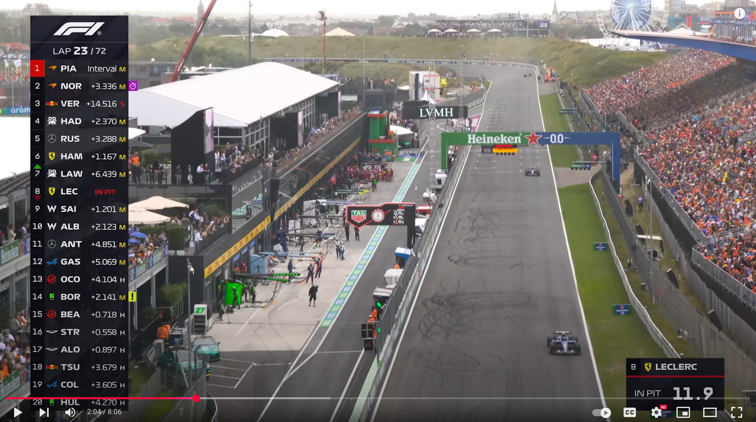
F1 passing video 1:27 – 2:04
Notes:
I'm going to play you a video (pause for beat) and I want you to imagine that you (emphasize) personally coached this professional athlete. Just think to yourself what wisdom did you impart to help them grow from pretty good to this level of mastery?

Slide 5
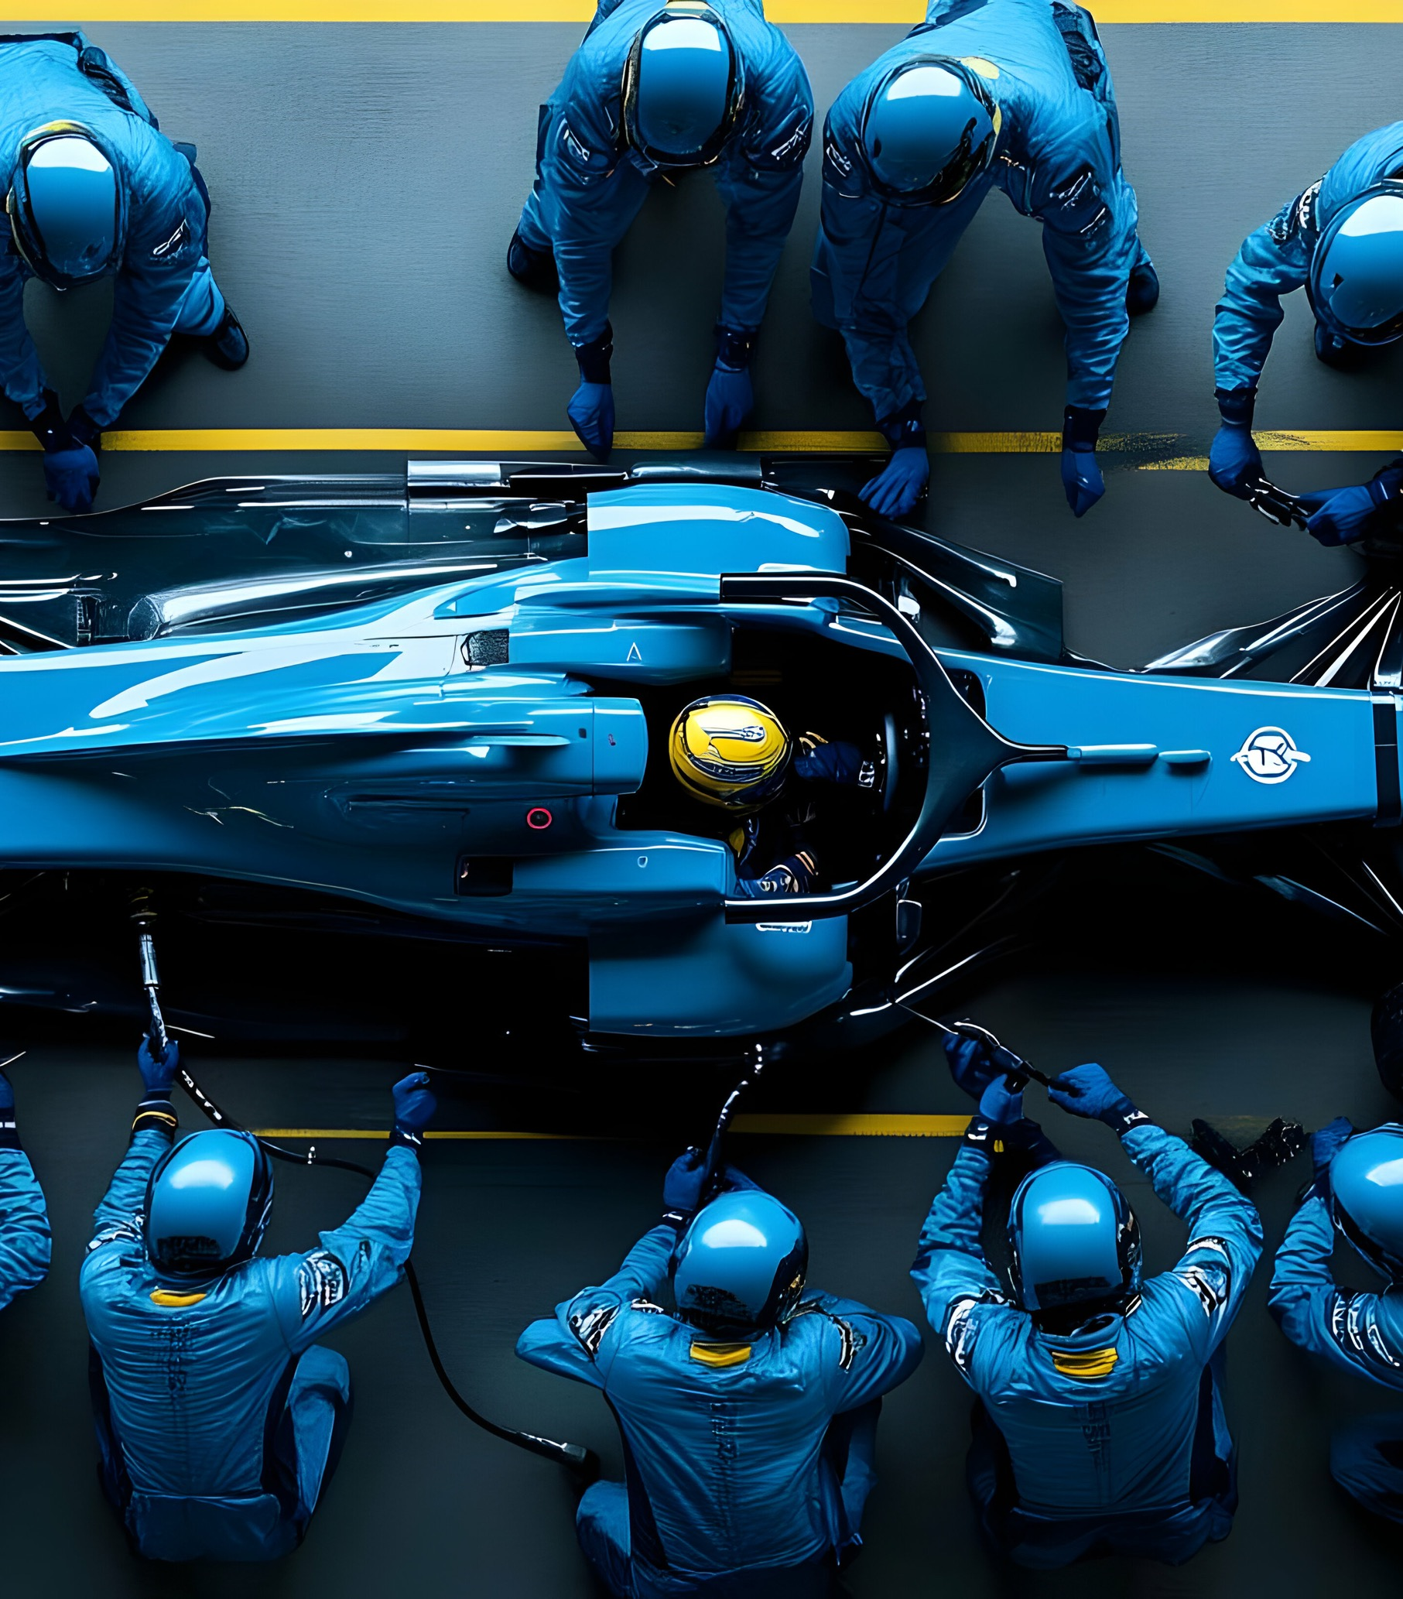
F1 coaching wisdom
It’s still about the fundamentals
You have to see the big picture
And then there’s the chess match
Notes:
Think about it – these drivers were already pretty amazing, actually really good, before they ever got to F1. But then F1 teams and coaches took them from "really good" to "absolutely world-class" over countless races. So what's the secret? How do you coach someone who's already performing at such a high level?
I dug into this, and here's what keeps coming up from the coaching experts:
It's still about the fundamentals. Rob Wilson – he's coached a ton of F1 drivers – says something really interesting. He believes the best drivers separate themselves by absolutely nailing the basics. We're talking about things like weight transfer, those tiny, precise inputs to the car. The stuff that might seem simple but is actually incredibly sophisticated when you master it.
You have to see the big picture. Here's what's fascinating – instead of obsessing over nailing each individual corner perfectly, the real focus is on putting together one complete, flowing lap. It's about understanding how the whole circuit feels, how everything connects together.
And then there's the chess match. Winning in F1 isn't just about being fast – it's about racecraft. That's your ability to read the field, know exactly when and how to overtake, and think several moves ahead throughout the entire race.
Now here's why I'm telling you all this – the wisdom that F1 teams use to develop world-class drivers? It's incredibly similar to what we want you to walk away with from this workshop.

Slide 6

Path to watsonx Orchestrate Advanced Skills
Advanced
Agentic Observability
Connections (team, member)
Advanced agent topics (context variables, collaborators, embed agents, etc.)
Knowledge bases via ADK (chunk size, overlap, citations)
Tools (write/deploy, flow tools, MCP toolkit)
AI Gateway (externall LLMs from Anthropic, OpenAI, Google, etc.)
Agentic best practices (security checklist)
Agent Development Lifecycle
wxO ADK/SaaS api
and lots more!
Intermediate
Install ADK on laptop
Install Developer Edition
Write/deploy agents via ADK
Connecting an external knowledge base index (Elasticsearch, Milvus)
Basics
Agents vs Assistants
Get hands on with wxO
No code UI explorer
Knowledge bases via UI
Notes:
So what are we really here to accomplish over the next two days?
Our main goal is to take your watsonx Orchestrate skills from where they are now to that advanced level where you feel truly confident. Now, I want to be clear about something – we're not just going to show you how to check boxes or follow documentation. That's just the surface.
What we're really after are those "aha moments" – you know, when you start seeing the patterns behind the features, understanding not just the what, but the why. Those insights that make you think, "Oh, now I get how this all fits together." The more you pick up on these underlying concepts, the more confident you'll become when you're facing those really complex agentic designs that seem intimidating at first.
Let's be realistic here – there's no way we're going to cover everything in just two days. That's not the point. What we can do is get you to that sweet spot where you walk away feeling confident about discussing watsonx Orchestrate with colleagues, building those custom demos that really showcase the platform, and – this is the big one – having those conversations with customers that lead to actual Proof of Concepts for their specific use cases.
That's what success looks like for our time together.

Slide 7
Agenda – Day 1
9AM - 11:00
Side Room:
Morning Brunch - Meet and greet with Instructors
Classroom:
Install / Debug Install of watsonx ADK + Developer Edition, and VS Code
11:00 - 11:30AM (30 min)
Daniel Benner
Introduction to workshop
11:30AM - noon (30 min)
Sophia Southard 5 Reasons Why IBM watsonx Orchestrate
noon - 1PM (1hour)
Daniel Benner
Welcome to the ADK Labs - Chat with documents agent
1M - 2PM (1 hour)
Sophia Southard
Model Context Protocol (MCP)
Lab - MCP
2PM - 3PM (1 hour) Sara Hrnciar Observability Lab - Observability
Afternoon refreshments in background – self serve
3PM - 4PM (1 hour) Daniel Benner AI Gateway
Lab - add external LLMs via gateway
4PM - 5PM (1 hour) Collin Stiffler Knowledge Bases Lab - ES, Milvus, and built-in
Evening Activity
Electric indoor cart racing
Notes:
AI

Slide 8
Agenda – Day 2
11AM-noon (1 hour)
Sara Hrnciar Flows Lab - Flow tools
noon - 1PM (1 hour)
Box lunches
Break time for calls and email
1PM - 2PM (1 hour)
Daniel Benner Agent Styles Lab - collaborator agents lab
2PM - 3PM (1 hour)
Daniel Benner Context Variables Lab - access agents via Slack lab
Lite snacks, afternoon coffee/tea/water/diet coke service
Time to finish all labs and engage in techie banter
End of workshop 4:30-5PM
Closing remarks
Nobody leaves without completing an evaluation
morning coffee/tea/water/diet coke service – self serve
8AM - 9AM (1 hour) Daniel Benner / Eugene Jung
Announcements
Recap yesterday's presentations and labs
Get feedback on Day 1
Review wxO resources:
PTEG, Sales Kit
ADK documentation
Agent Connect documentation
Official Documentation
Communities, etc.
9AM - 10AM (1 hour)
Sophia Southard Connections Lab - Connections
10AM-11AM (1 hour)
Sara Hrnciar Tools Lab – Tools

